Slide 2
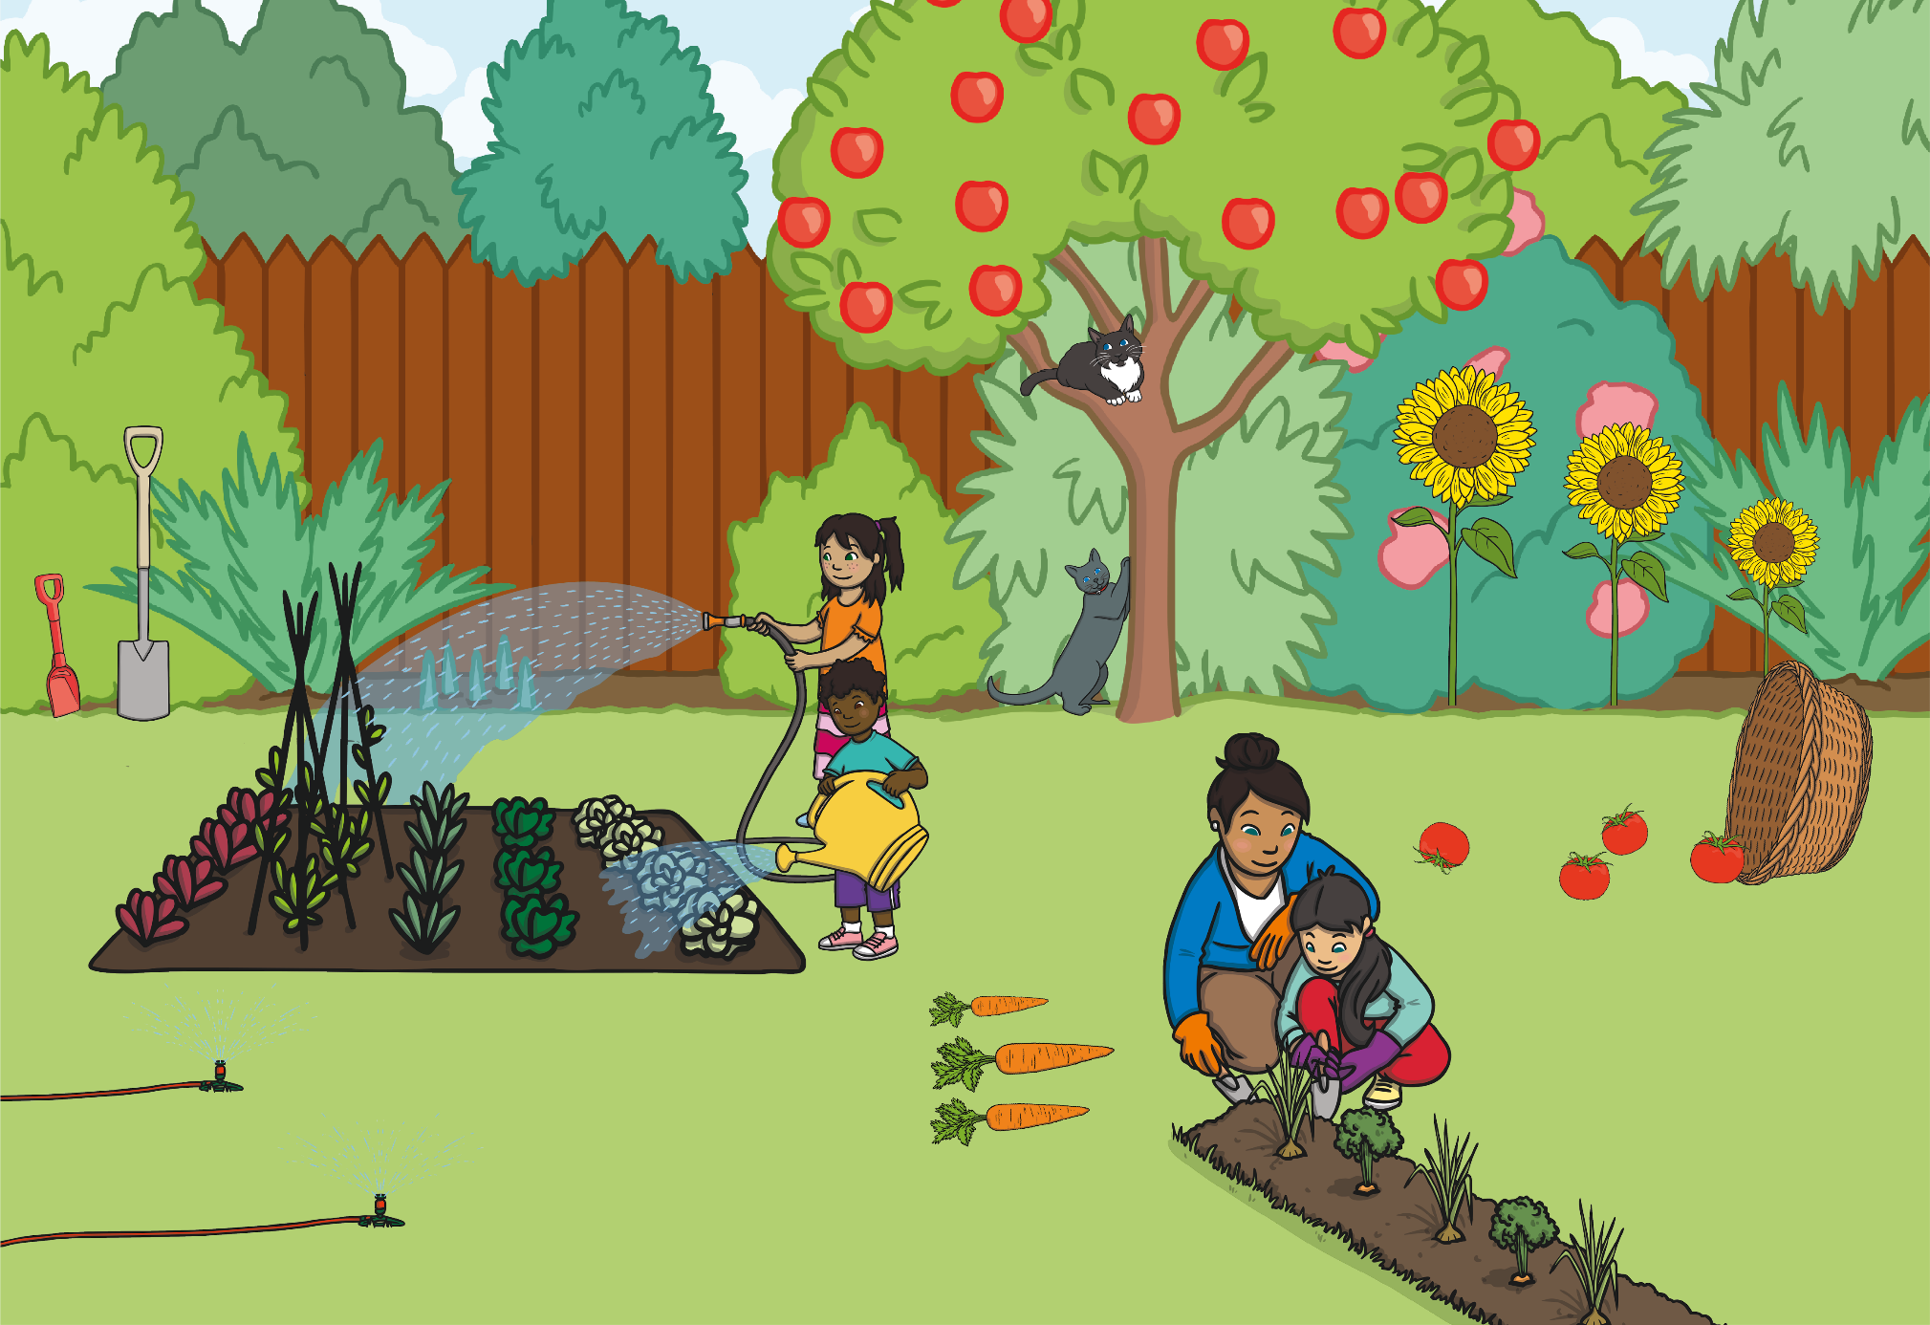

Slide 3
back to the picture
next

Slide 4
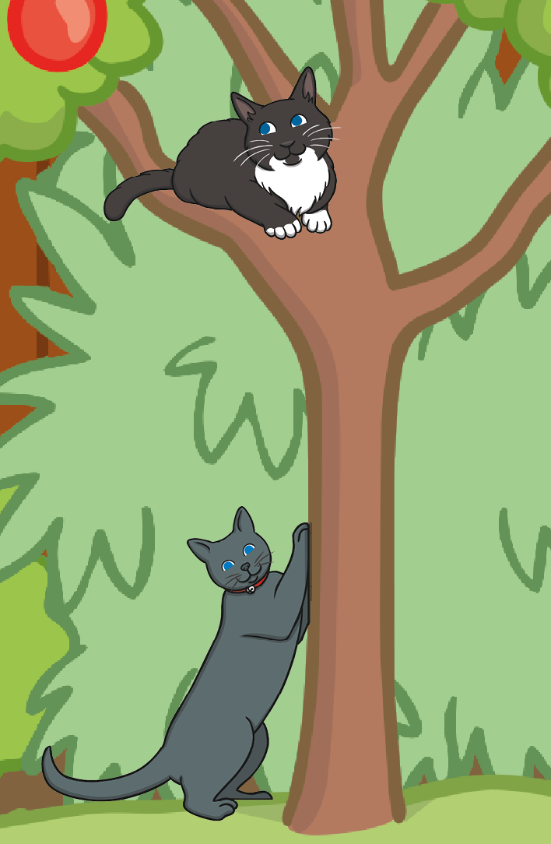
back to the picture
next

Slide 5
back to the picture
next

Slide 6
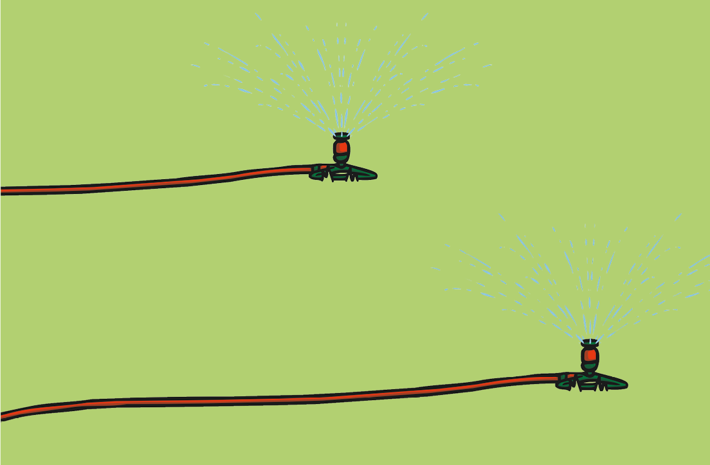
back to the picture
next

Slide 7
back to the picture
next

Slide 8
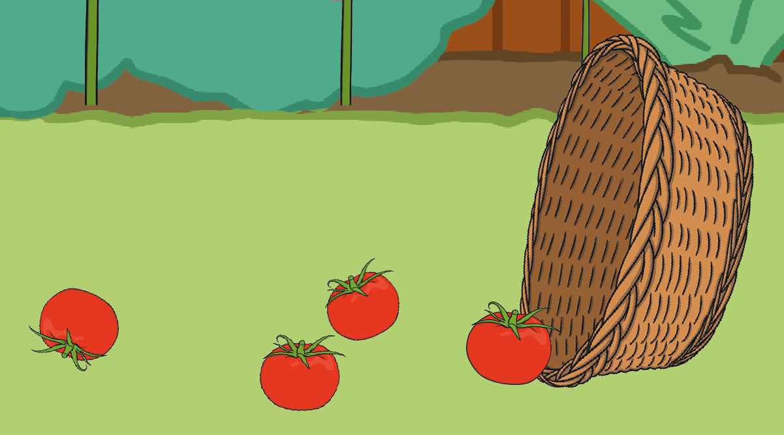
back to the picture
End

