Slide 1
IALT be able to take notes from a range of texts.

Slide 2
Why Take Notes?
To gather information about a specific topic.
To use within a piece of writing at a later date.
To analyse a text.
To revise for a test.

Slide 3
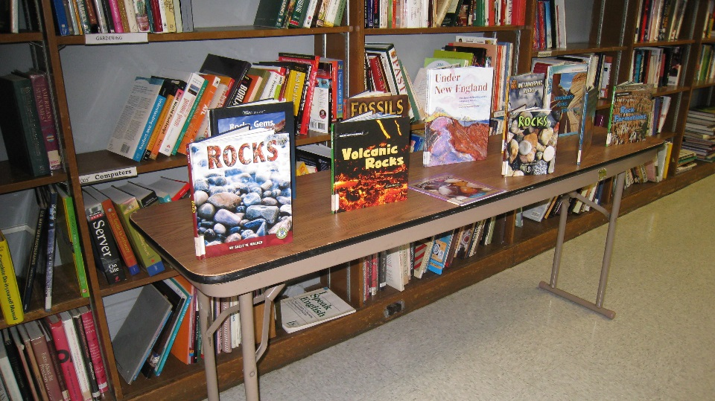
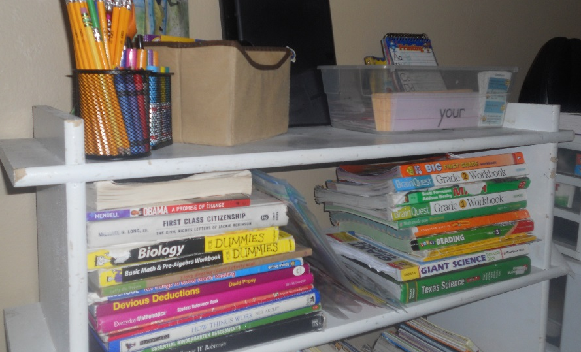
Where Do I Begin?
When you first open a book, especially for a complex subject, it can be very intimidating.
The idea that you have to look at all this information and pick out the important parts can be very overwhelming.
Where do I start?
How do I know which information is important?
How can I shorten the sentences?
Photo courtesy of manchesterlibrary, lynlomasi (@flickr.com) - granted under creative commons licence – attribution

Slide 4
Don’t Panic!
There are a few different tricks and tools that you can use to make this easier.
Look at the pictures and headings.
Read and take notes on one subheading at a time.
Make helpful notes.

Slide 5
Examine the Pictures and Headings
Look carefully at any pictures and diagrams as they may give you more information or help to explain things.
You can use the headings from the text as the main points in a plan for your notes if you want to.

Slide 6
Read and Take Notes on One Subheading at a Time
Work on one sub-heading at a time. Look for key words in the text and
write down key information as you go.
Once you have found the correct section, you do not have to read every single word.
Skim over each sentence, taking in the important facts.

Slide 7
Writing down Only the Key Information
Decide what is most important and write that down.
Only write down key words and phrases; you do not need to write in full sentences.

Slide 8
Write down Only the Key Information
For example:
Life in ancient Egypt was centred largely on agriculture. The majority of the people were involved in farming, and the growing season lasted eight to nine months. Wheat, fruits and vegetables were the principal crops, although there was some pastoral farming of cattle, sheep or goats. Farmers in ancient Egypt worked to reach a level of subsistence so that they could feed themselves and pay their taxes. During the annual flooding of the Nile, which typically lasted from July until November, farming was impossible. But when the waters receded, a thick layer of fertile silt over the farmlands remained, to ensure rich soil for their crops and thick grasses for their grazing animals.
Mainly agriculture - growing season – eight to nine months – wheat fruits vegetables - some cattle sheep goats - feed themselves - pay taxes - annual flooding – Nile – July until November - farming impossible – when waters receded – left layer fertile silt - crops - thick grasses for grazing animals.

Slide 9
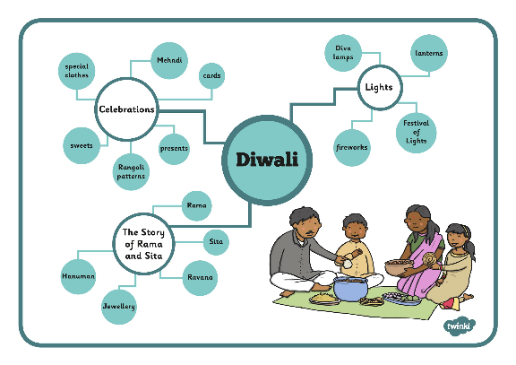
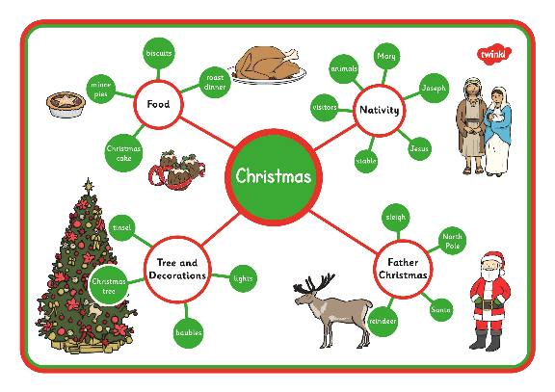
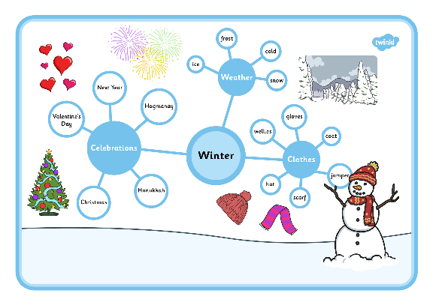
You could use Concept Maps
With a concept map, you are creating a visual display that helps to explain the relationships between ideas and the main topic.

Slide 10
Over to you…
Watch the video again and jot down the key points on note taking.
They should help you remember the most efficient and helpful way to record information in note form.

