Slide 1
Daily Phonics Home learning
Summer 2 week 6 lesson 5
The weeks lessons focus on consolidating: phonics sounds, months of the year, days of the week, year 1 tricky words, Year 1 punctuation and suffixes.

Slide 3
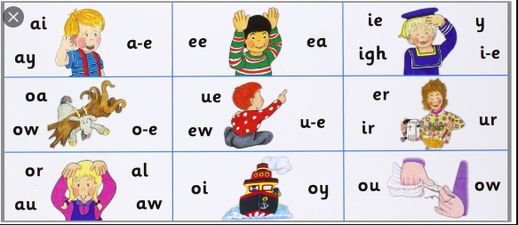
Teacher: sound talk words for children to blend…
Notes:
Players shapes teeth flight turn flew boy couch

Slide 4
were
what
like
there
little
out

Slide 5
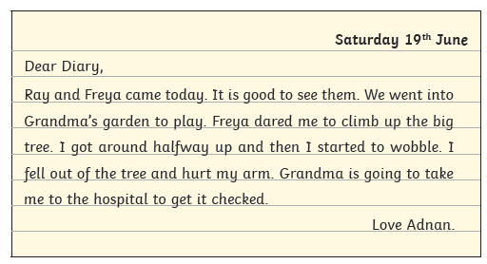
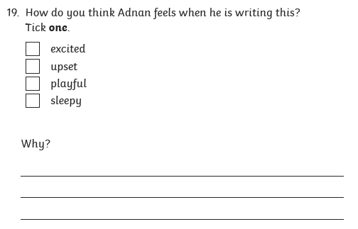

Slide 6
Dictated sentence:
Notes:
I love Fridays because I get to see my friends.

