Slide 1
Daily Phonics Home learning
Summer 2 week 6 lesson 3
The weeks lessons focus on consolidating: phonics sounds, months of the year, days of the week, year 1 tricky words, Year 1 punctuation and suffixes.

Slide 2
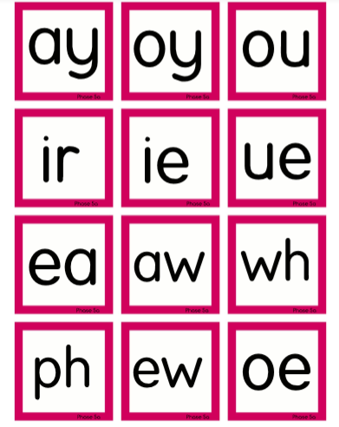
Point to and say each of the sounds

Slide 4
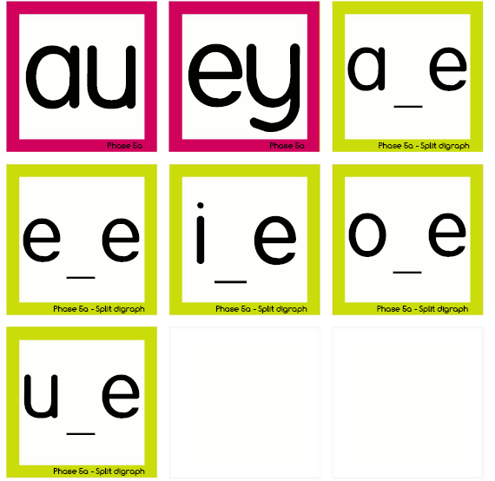
Notes:
Point to and say each of the sounds - type into google if unsure on sounds

Slide 5
Wednesday
Thursday
Friday
Saturday
Sunday
Monday
Tuesday
Notes:
Read and compose sentences

Slide 6
Write a sentence featuring a day of the week…

Slide 7
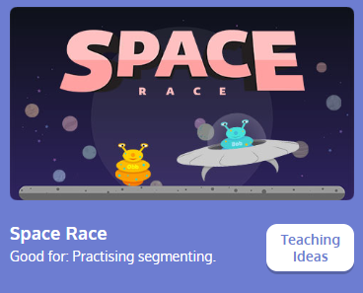
Practise blending words
with phase 4 sounds

Slide 8
eleven
twelve
Can you write the numbers in words from 11 – 20
Challenge yourself and write without looking.
thirteen
fourteen
fifteen
sixteen
seventeen
eighteen
nineteen
twenty

Slide 9
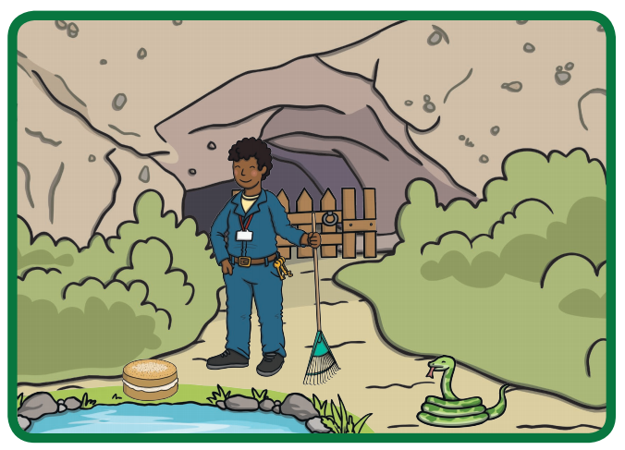
Can you spot the a-e things in the picture -

Slide 10
Play the game, match the opposite words.
School – use cut up game.
Home – go onto the next slide

Slide 11
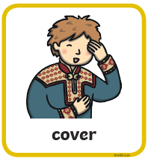
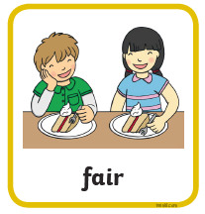

Slide 12
