Slide 1
Daily Phonics Home learning Week 2 lesson 1
These power-points are very similar to what the children are used to viewing and participating in each day.
With a twist they are slightly longer, 25-30 minutes, so you may want to do it in two 15 minute slots to accommodate at least one writing opportunity and conversation ideas.
- View ‘normal’ then you can see notes column (when instructed use full screen – slide show)

Slide 2
Read tricky words:
Write tricky words
that
about
at
make
here

Slide 3
Complete the maths related sentences:
That is the largest …… I have seen …
I am about ……tall and my longest finger is …cm.
Today I will have my lunch at …..
I can make the greatest…
Look here I found these small….
Notes:
Extend: by making your own sentences up with the 4 key words or write sentence/s

Slide 4
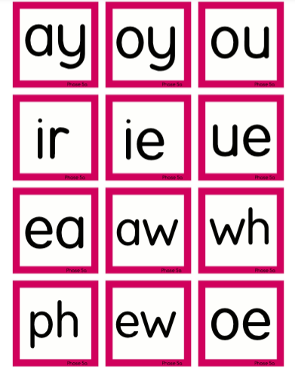
Point to and say each of the sounds
Notes:
Point to and say each of the sounds - use jollyphonics website and youtube to help support hearing the sounds

Slide 5
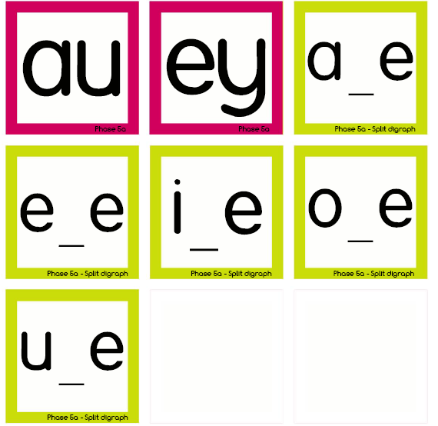
Notes:
Point to and say each of the sounds - type into google if unsure on sounds

Slide 6
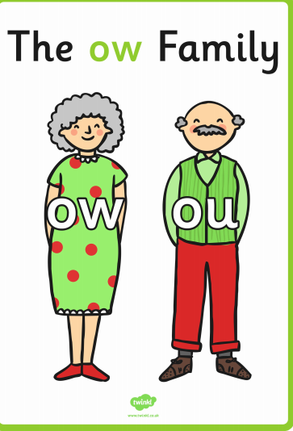
Read these sentences –
Spot the ou/ow family words -
Sounds came across the
town from the funny brown house .
He shouted so loudly that it made the window shake.
How do the clouds stay in the sky?
Notes:
To link with home learning last week.

Slide 7
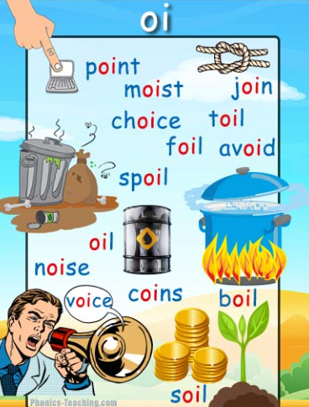
Sound talk and read the oi words
Make a list of your own oi words

Slide 8
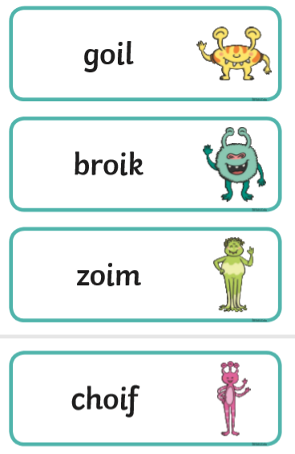
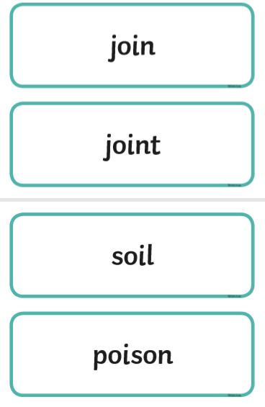
Sound talk and read the oi alien and real words

Slide 9
Read these sentences –
Will it spoil a toy mouse if you boil it in oil?.
Dig deep in the soil and you might find gold coins.
Notes:
Please note some of the sentences are strange because they need to contain words with the given sound/s in.

Slide 10
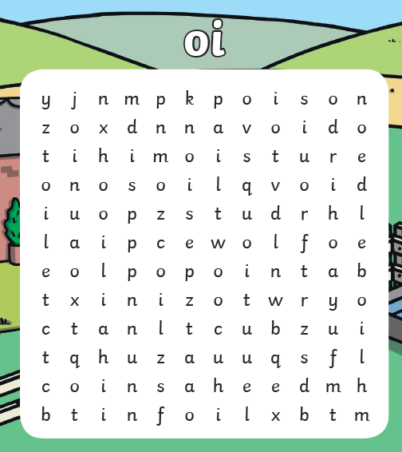
Notes:
Print slide or do from the screen (easier on slide show version)

Slide 11
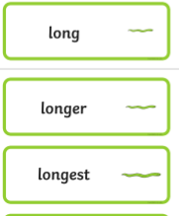
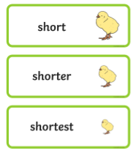
Use sentence starter
Yesterday I …
and complete a sentence/s
Challenge to use any of these size words –

Slide 12
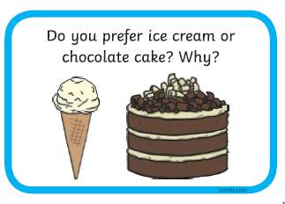
Conversation:
Encourage reasoning…
Notes:
Talk partners is something the children are used to using at school – talking to a peer and sharing ideas on a question or subject. You may or may not be able to do this depending on other sibling ages, so it may be between you and your child.

