Slide 1
Are Island a paradise or in peril
May 19
2020
by Navvya Mohan Kumar

Slide 2
This presentation is all about ….
Are island a paradise or in peril
what is a paradise?
paradise is a place of exceptional happiness and delight,
there is only peace, prosperity, and happiness in a paradise.
And what is a peril?
Peril is a serious and immediate danger.

Slide 3
Paradise & Peril
Paradise
Peril
More in detail of paradise
Paradise is a place of contentment, a land of luxury and fulfillment. Paradise is often described as a "higher place", the holiest place, in contrast to this world, or underworlds such as Hell.
More in detail of peril
A peril is something that can cause a financial loss. Examples include falling, crashing your car, fire, wind, hail, lightning, water, volcanic eruptions, falling objects, illness, and death.

Slide 4
Example ………….
paradise Sentence Examples
.Its old-fashioned garden was the paradise of my childhood…
.At times my heart soars like an angel at the gates of paradise at the mere thought that a part of him is now a part of me..
.It isn't all paradise, is it???
peril Sentence Examples
Gibbon's stylistic artifice both averted the peril of prosecution and rendered the attack more telling. ...
The hour of peril for the Latin kingdom had now at last struck. ...
imminent peril of his life.

Slide 5
Answer the question
To answer the question “ Are island a paradise or in peril” I learnt about island and found facts about them and also mapped them in the google map and did more things …
And I think the answer is island are paradise and peril , because some island are peril and some are not and they are paradise.

Slide 6
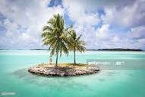
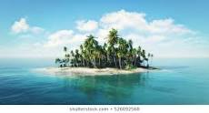
Thank you!
This is the end

