Slide 1
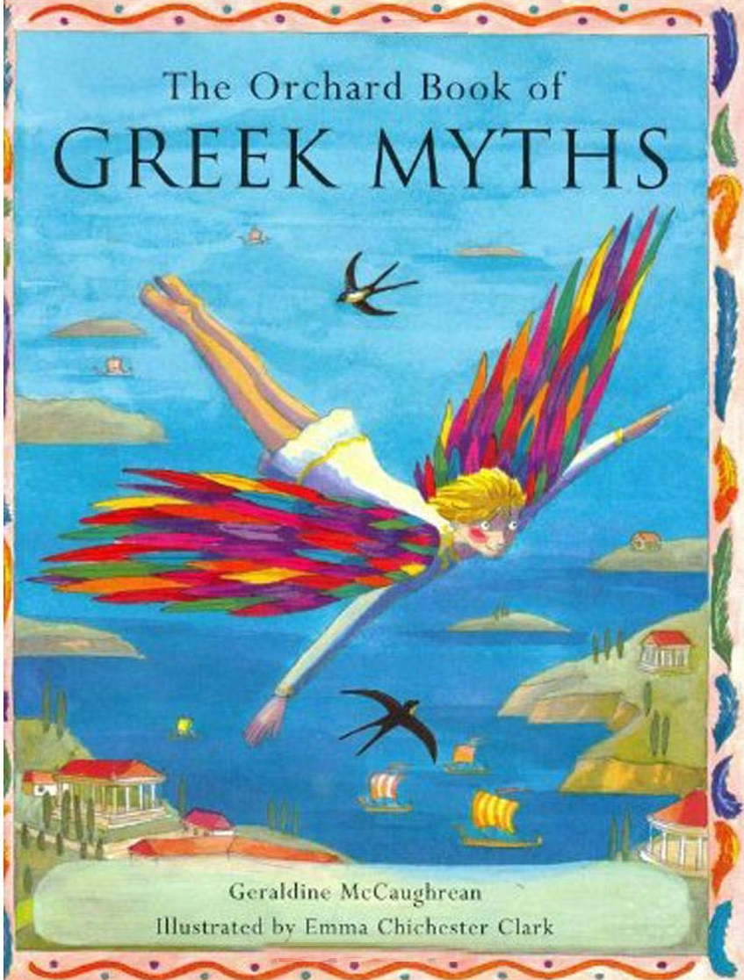
Greek Myths
IALT: be able to appraise Greek Myths.
SOS:
Read a range of Greek Myths,
State what you did and
didn’t like about them,
Give clear reasons for
your opinions.

Slide 2
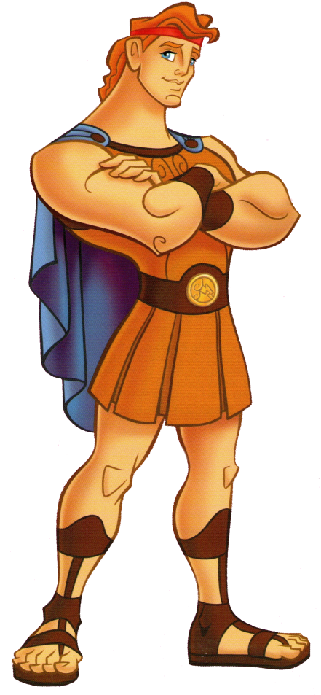
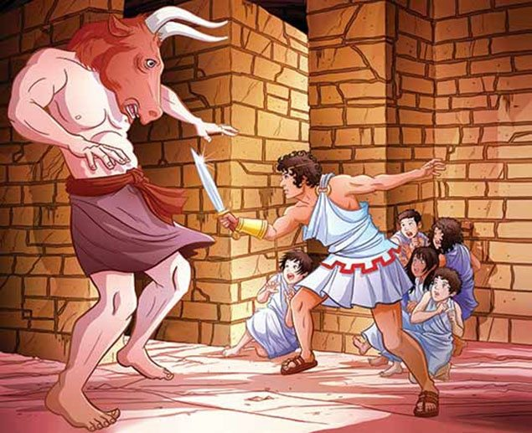
Greek Myths
What myths do you already know? What about the characters in them? How are they different from other genres?

Slide 3
Greek Myths
Over to you… Use the questions to help you appraise two or three of the myths.
1. Did you like the story?
2. What did you like/not like about it?
3. What are the key features of a Greek myth?
4. Do they follow a particular structure?
5. Does the one you’ve just read follow these features and structure?
6. Is there anything you’d improve about the story/
For all of the above questions, make sure you say why and explain your thoughts and opinions in detail.

