Slide 1
Dexter’s shadow presentation

Slide 2
How is a shadow created?

Slide 3
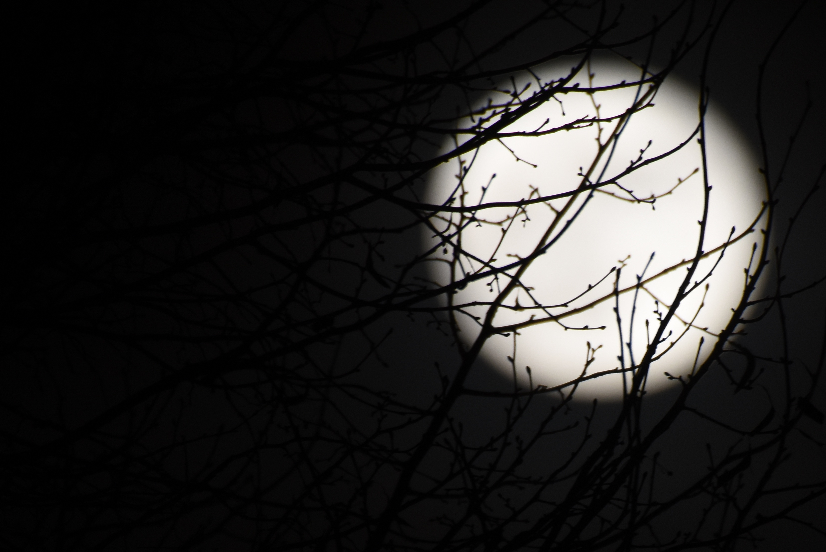
A shadow is made with…
Light and Dark

Slide 4
To make a shadow you need light and something opaque to block the ray of light
Then it will make the shape of the object
Then that is a shadow.
Like this…

