Slide 1
Welcome

Slide 2
Welcome It is wonderful to see so many of you here today.
Today is a quick tour on how we teach phonics and reading in Early Years.
We will then talk a little about our plans to roll out Evidence Me to you in the following weeks.
If you have any questions, please don’t hesitate to ask during the presentation as the chances are if you are wondering something, someone else is too.
So here goes…………….

Slide 3
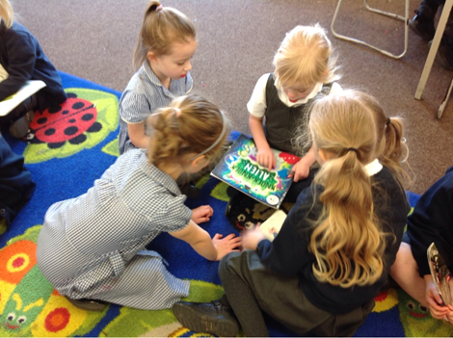
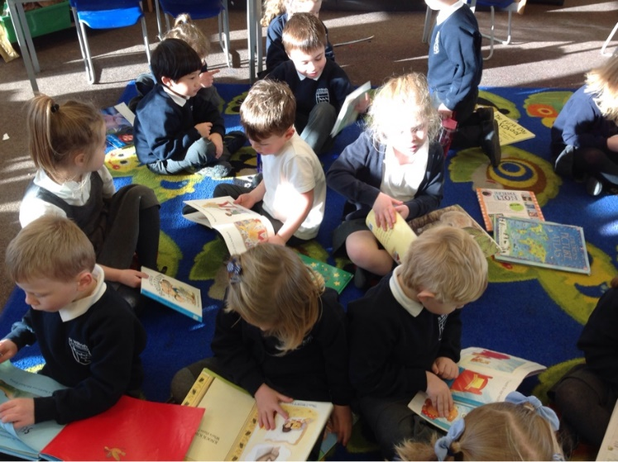
Welcome

Slide 4
44 sounds but spelt in about 140 different ways!

Slide 5
Terminology:
Phase 2 phonemes
Phoneme - The smallest unit of sound.
Grapheme - A way of writing down a phoneme. Digraph - A grapheme containing two letters that makes just one sound (e.g. ay, ai).
Trigraph - A grapheme containing three letters that makes just one sound (e.g. igh)
Phase 3
Notes:
Give examples of words.

Slide 6
By the end of Early Years your child will have been introduced to all of the 44 sounds.
The most common sound that each letter in the alphabet represents and then the most common digraph, trigraph for each sound.
Top tip : each letter has a sound that it represents and a name.
For example ………..

Slide 7
a
Its name is ‘a’ but is represents the sound ‘a’ and sometimes ‘ai’
hat
Amy

Slide 8
By the end of Early Years the children will also have been introduced to tricky words. These are words that you cannot segment. We also add some high frequency words (sight words) that can be blended and segmented. Eg. and
Tricky Words

Slide 9
Can we find it ?
and
the
go
into
to
no
the
into
the
Phase 2
Notes:
This a game we play to spot the word we are learning, the board will be covered with words and they come and ring the word.

Slide 10
Phase 3

Slide 11
So how we do it?
Each morning the children have a phonic session.
It can be organised in different ways.
Whole class with two adults supporting the children.
Two groups where one adult will be focussing on Physical Development and handwriting outside and then swap.

Slide 12
Imagine you are four or five, this is an example of a phonics session.
We have lots of games and props that we use to keep the children engaged.
There is a pattern to it :

Slide 13
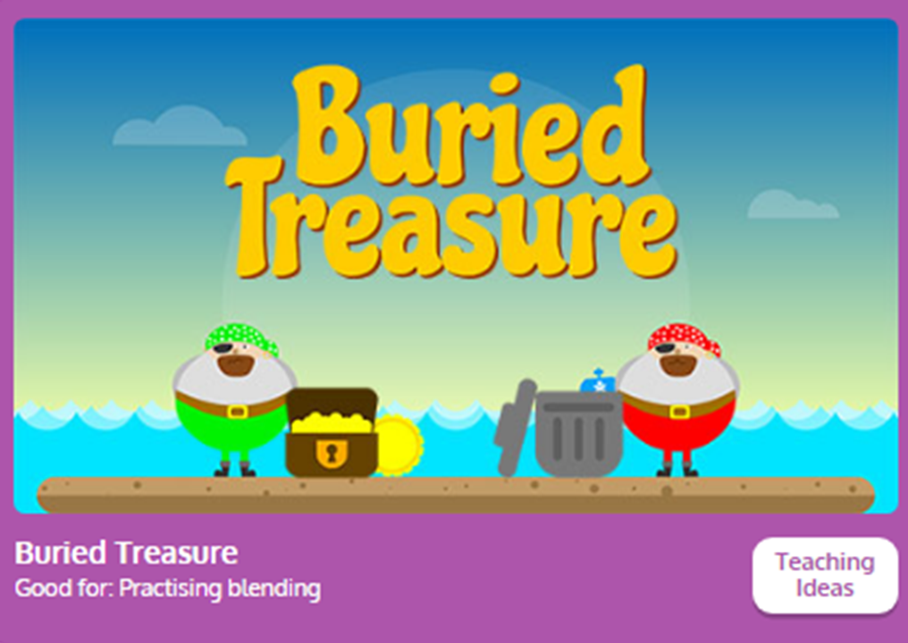
Revise
Revise the sounds we have learnt so far.
Notes:
We may play a game to revise sounds or to read cvc words using phonemes they are finding tricky.
Model blends in segmenting. But we are going to show you clap clap turnaround.

Slide 14
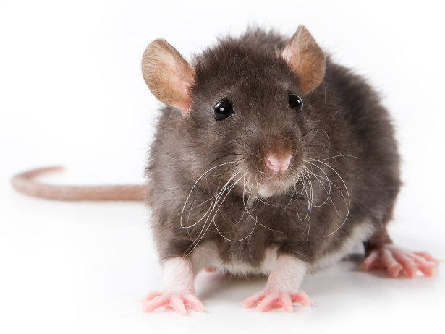
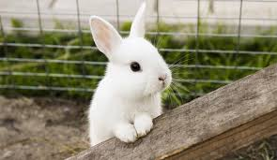
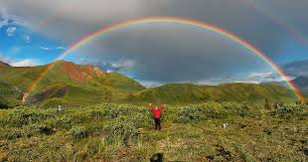
teach
What phoneme are we learning today?
We may say a rhyme for the children to work out the sound.

Slide 15
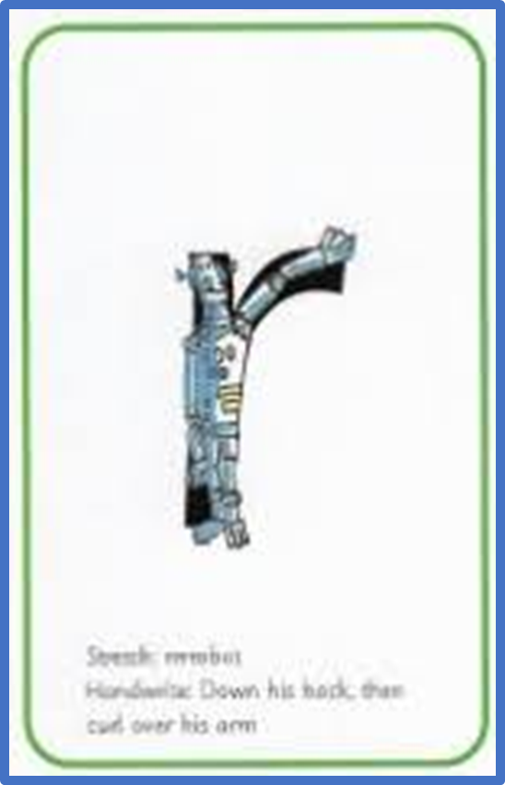
What happens to your mouth and tongue when you say that sound?
The sound must be pure.
For example -

Slide 16
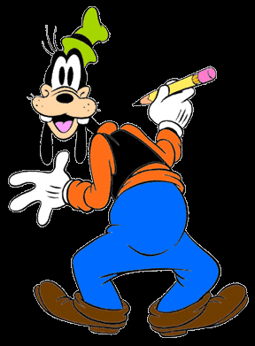
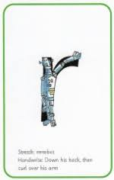
Lets write it…………….
We write in different ways:-
Magic writing
Crayons- helps with pencil grip.

Slide 17
teach
Write…
We may say a rhyme for the children to work out the sound.

Slide 18
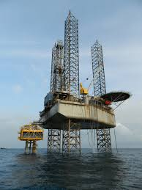
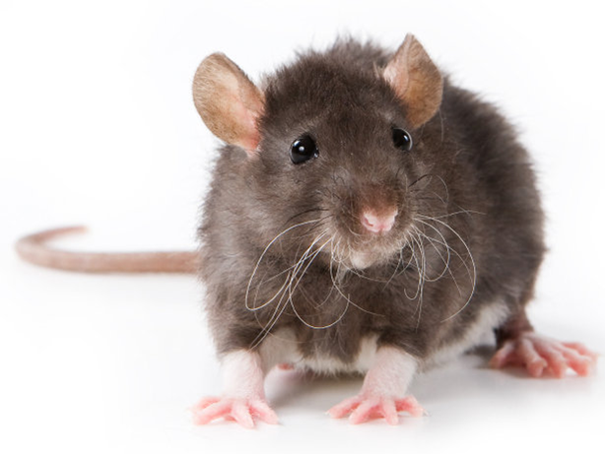
Practise
Lets match the words to the pictures
rat
ri g
This is how we segment and blend.

Slide 19
Lets play gotcha
sun
red
rip
bed

Slide 20
I got the red rag.

Slide 21
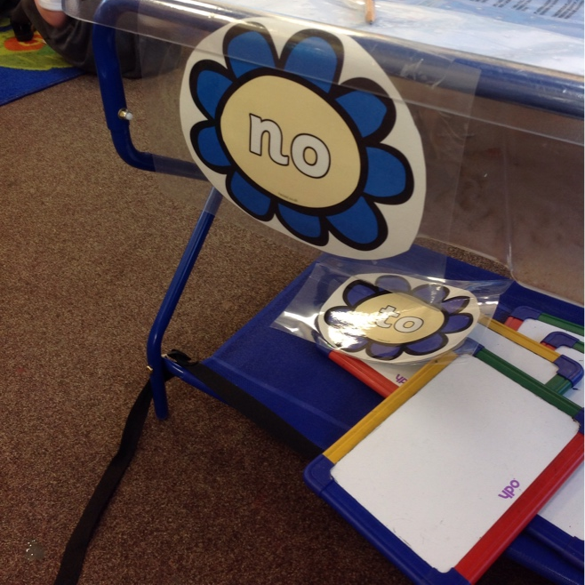
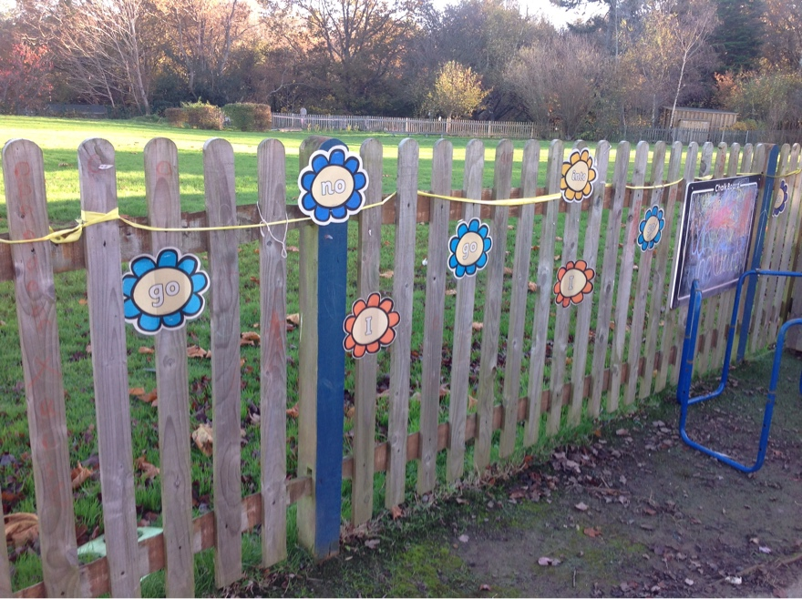
How does phonics look in our environment?
Because phonics is a discrete lesson, we create a bridge between phonics and learning projects (independent learning) to encourage children to use what they have learnt.

Slide 22
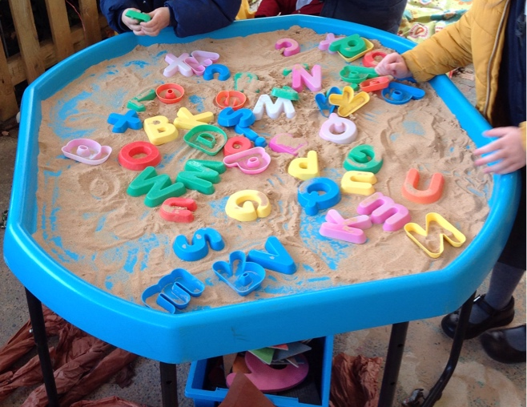
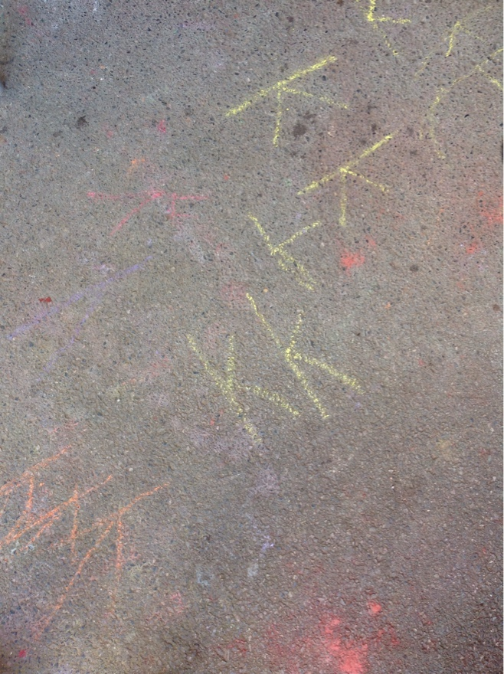

Slide 23
Phase 3
As the children progress, single words become captions which then become sentences, which then include conjunctions, adjectives for both reading and writing.
Presently, children who are working beyond age related expectations are scaffolded dependent on their needs.

Slide 24
How reading is taught in Early Years:
phonics sessions – these are the foundation of all decoding and spelling .
1:1 reading with an adult
Book hook
Whole class shared reading
Independent reading
Shared reading
Games

Slide 25
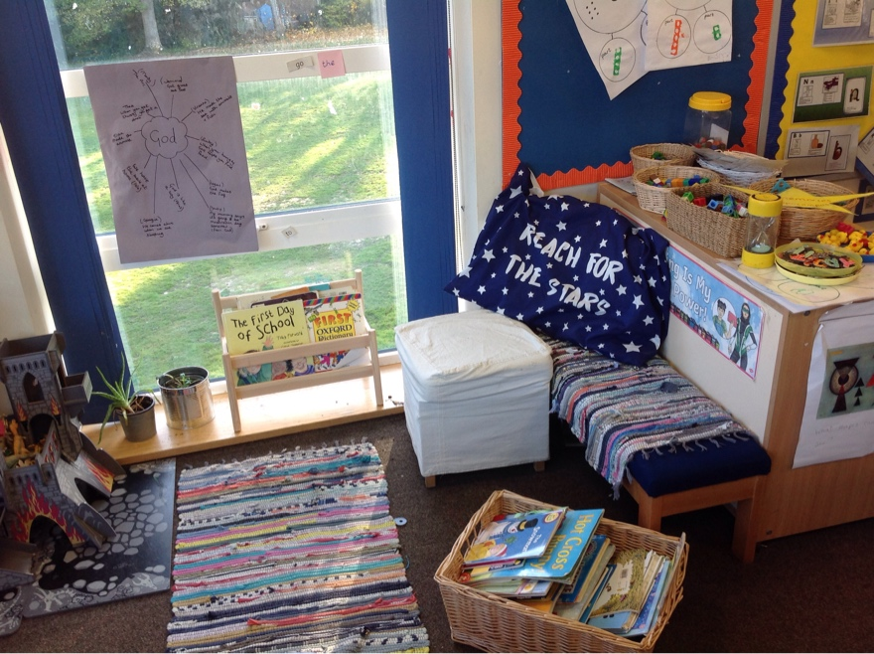
What does Reading look like in Reception?

Slide 26
Reception – language and listening skills
Year 1 – phonics and reading skills
Year 2 – focus on using these skills to improve writing

Slide 27
How you can help your child:
Practise reading with your child every day (5 minutes)
Please write any comments about their reading in the reading diaries
We will start with certificates next Wednesday- we will count back for the beginning)
Talk about the story and ask questions – how do you think (character) is feeling? Do you know what (word) means?
Read to your child – quality texts that are of a higher level.
Quality text enables you to model all the skills of reading to your child and expands their language and vocabulary.
That is why from the time your child has been at St Wilfrid’s they have brought home a storybook every week.

Slide 28
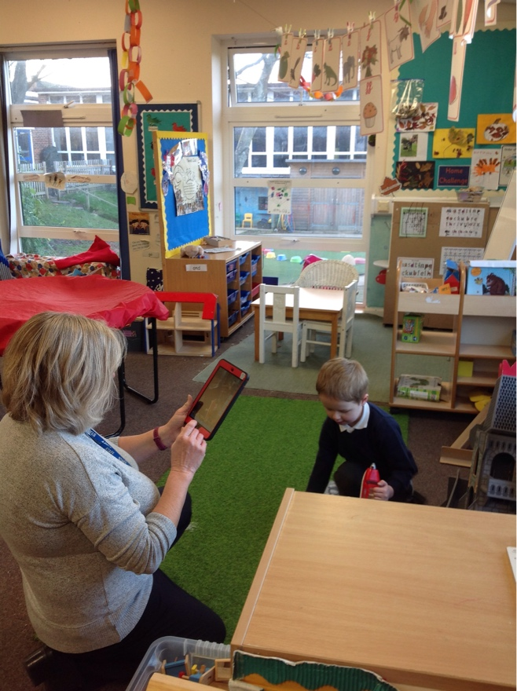
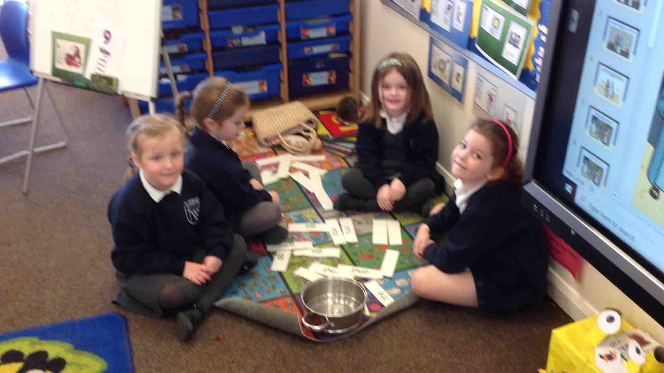
How do we record your child’s achievements?

Slide 29
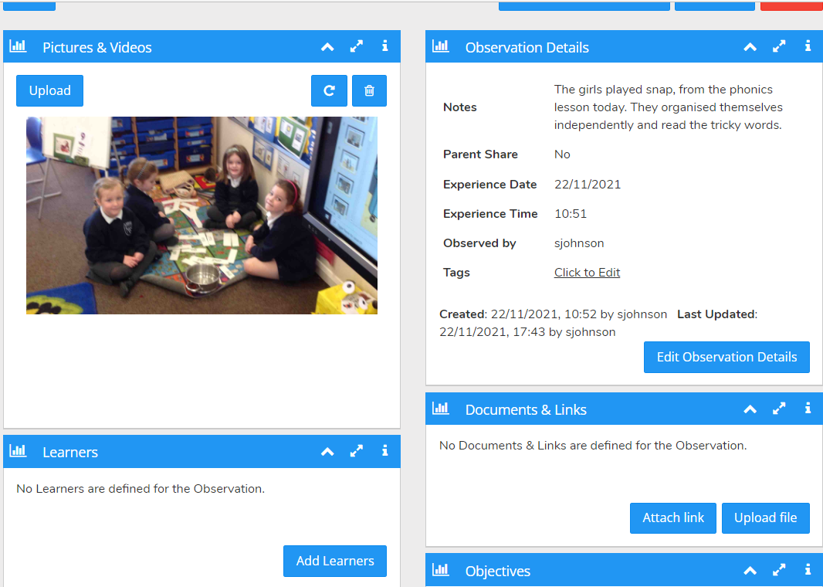

Slide 30
Many of you would have had a similar experience at Nursery.
During the day our priority is to play with, interact with and observe your children because it is through this, that we are able to scaffold their learning.
During learning projects, (children's independent learning) we record the children's achievements through photos and videos as and when it is appropriate and does not impede on the child’s learning or our interactions with them.

Slide 31
The exciting bit …………
We would like to link you to Evidence Me to enable you to see examples of your child’s learning.
The reason this is important is that is enables you to then send us stories regarding your child's learning at home, on the same app.
It was wonderful to hear how some of our children retold our firework poem to you at home. This system will hopefully make it easier for us to work together to support your child.

Slide 32
How will it work?
As you know, there are seven areas of learning in Early Years.
The pillars are:
Physical Development
Communication and Language
Personal, Social and Emotional Development
From that we have a further four, all of which are equally important to your child’s development:
Literacy
Maths
Understanding the World
Expressive Art and Design
Notes:
(Bare with us, this is new for our school and like all online things there maybe glitches but that’s life!!

Slide 33
On a Thursday, we will continue to send you a newsletter describing your child's learning for that week.
We will select a focus each week from one of the areas of learning and you will be sent information which relates to that focus.
This will be sent out the following week.
Please then respond through the app, if your child talks about, responds to the learning at home.
We can then celebrate your child’s achievements together.

Slide 34
Together we will be our best!
You will be receiving a letter via Ping in the next few days to sign up to use the app.

Slide 35
Thank you for coming!

