Slide 1
wild about science
By Noah Whitley

Slide 2
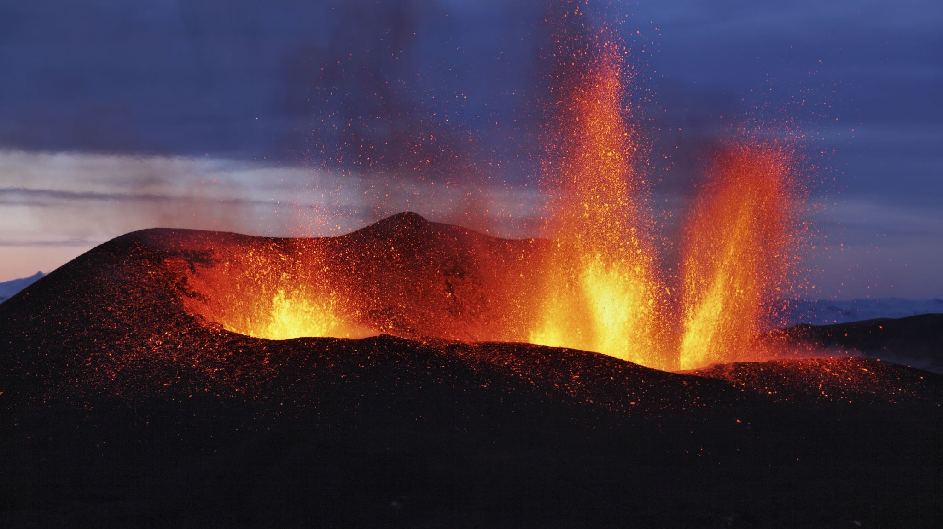
When science is hot!
True or false?
Burning happens inside the engine of the a plane.
Fire! Flames! Burning! Heat!
The science of heat is important in all kinds of ways. Not only do we cook with heat, but we also warm our homes and heat water. Burning happens in all kinds of engines in cars, trucks, planes and rockets. It is also used in factory processes, from making steel to shaping plastics.

Slide 3
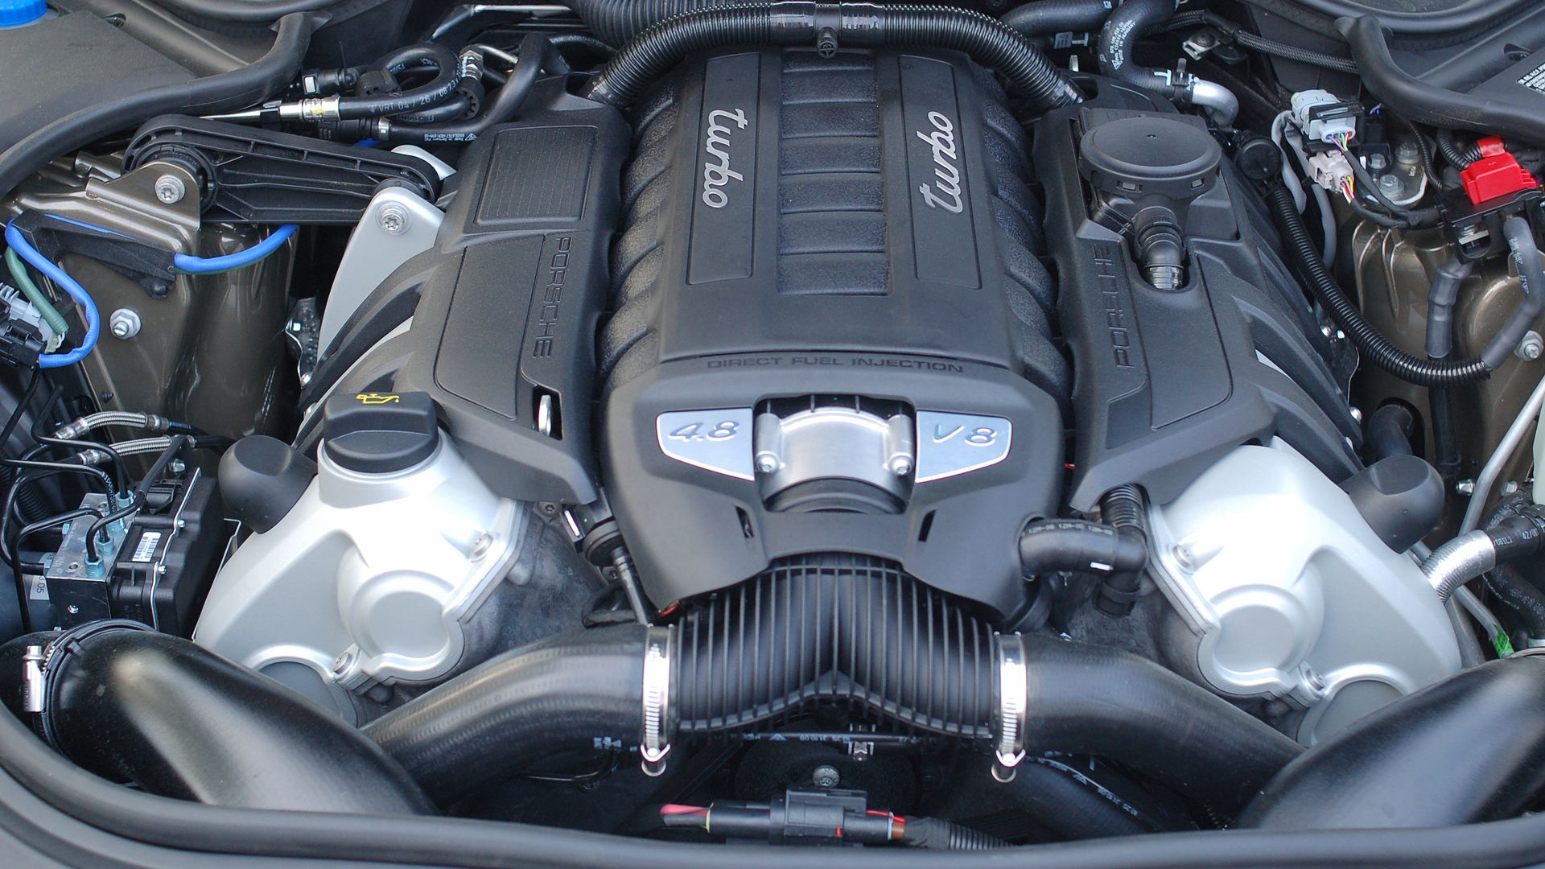
Engine power
Imagine having to walk or run everywhere instead of riding in a car. Engines are machines that use fuel to do work for us and make life easier. Fuel is a substance that has chemical energy stored inside it. The energy is released as heat by burning or exploding the fuel in the engine.
This Photo by Unknown Author is licensed under CC BY-SA

Slide 4
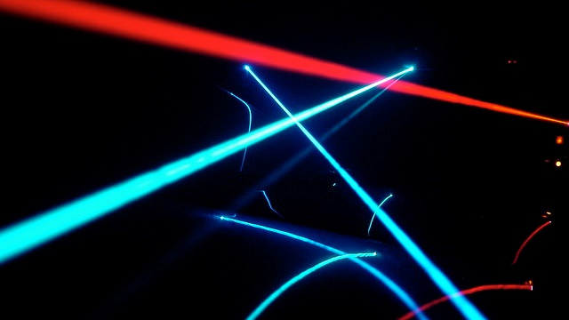
The power of lasers
Laser light is a special kind of light. Like ordinary light, it is made of waves, but it has three main differences. Ordinary white light is a mixture of colors, while laser light is one pure color. Ordinary light waves have peaks (highs) and trough (lows), which do not line up – laser light waves line up perfectly. Lastly, ordinary light spreads and fades. A laser beam can travel for thousands of kilometers as a strong, straight beam.
This Photo by Unknown Author is licensed under CC BY-SA

Slide 5
Electric sparks!
Flick a switch and things happen. The television goes of, the computer comes on, lights shine and music plays. Electricity is our favourite form of energy. We send it along wires and plug hundreds of machines into it.
This Photo by Unknown Author is licensed under CC BY-SA

Slide 6
Mysterious magnets
Without magnets there would be no electric motors, computers or loud speakers. Magnetism is an invisible force to do with atoms – tiny particles that make up every thing. Atoms are made of even smaller particles, including electrons.
This Photo by Unknown Author is licensed under CC BY-NC

Slide 7
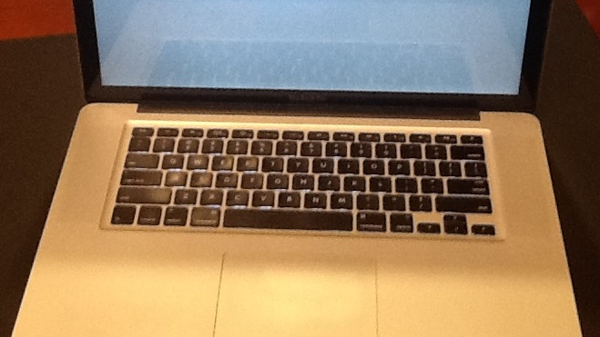
Compu - science
Computers are amazing machines, but they have to be told exactly what to do. So we put instructions and information, by various means. These include typing on a keyboard, inserting a disc or memory stick, downloading from the internet, using a joystick or games controller or linking up a camera, scanner or another computer.
This Photo by Unknown Author is licensed under CC BY

Slide 8
World of chemicals
The world is made of chemical substances. Some are completely pure. Others are a mixture of substances – such as petroleum (crude oil). Petroleum provides us with thousands of different chemicals and materials, such as plastics, paints, soaps and fuels. It is one of the most useful, and valuable substances in the world.
This Photo by Unknown Author is licensed under CC BY-SA

Slide 9
Web around the world
The world is at your fingertips – if you are on the internet. The internet is one of the most amazing results of science. It is a worldwide network of computers, linked like one huge electrical spiders web.
This Photo by Unknown Author is licensed under CC BY-SA

Slide 10
What's it made of
you wouldn’t make a bridge out of straw or a cup out of bubblewrap. Choosing the right substance for the job is important. All the substances in the world can be divided into several groups. For example, metals such as iron, silver and gold are strong hard and shiny, and conduct heat and electricity well they are used to make things that have to be strong and long lasting.

Slide 11
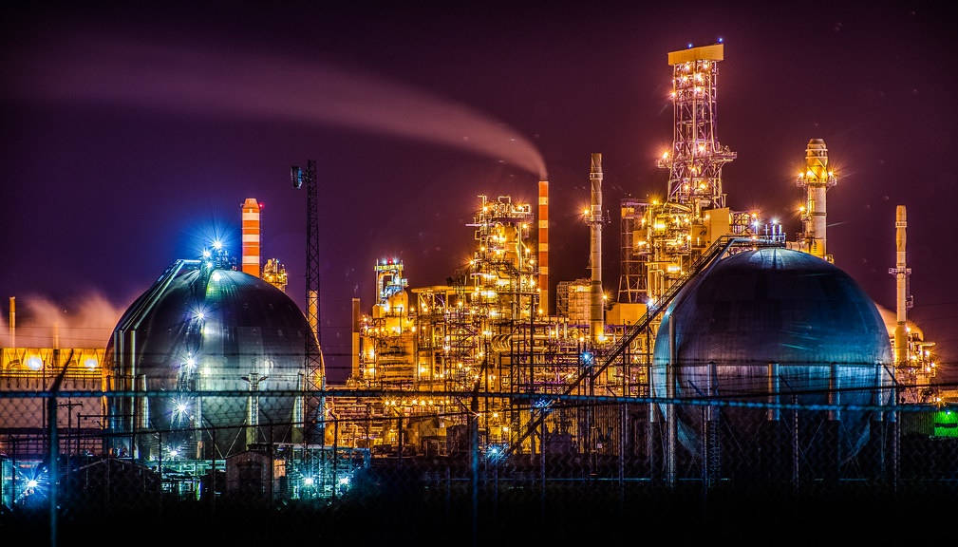
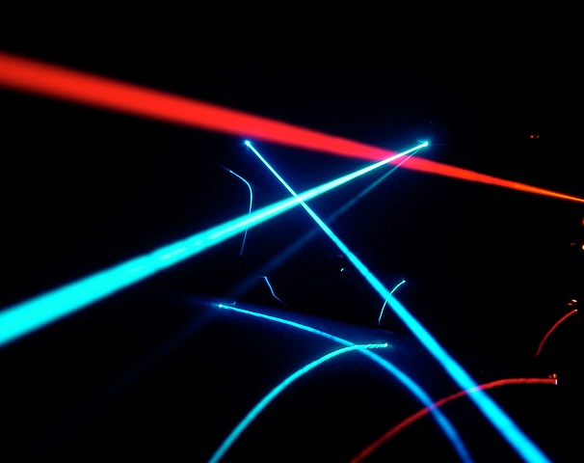
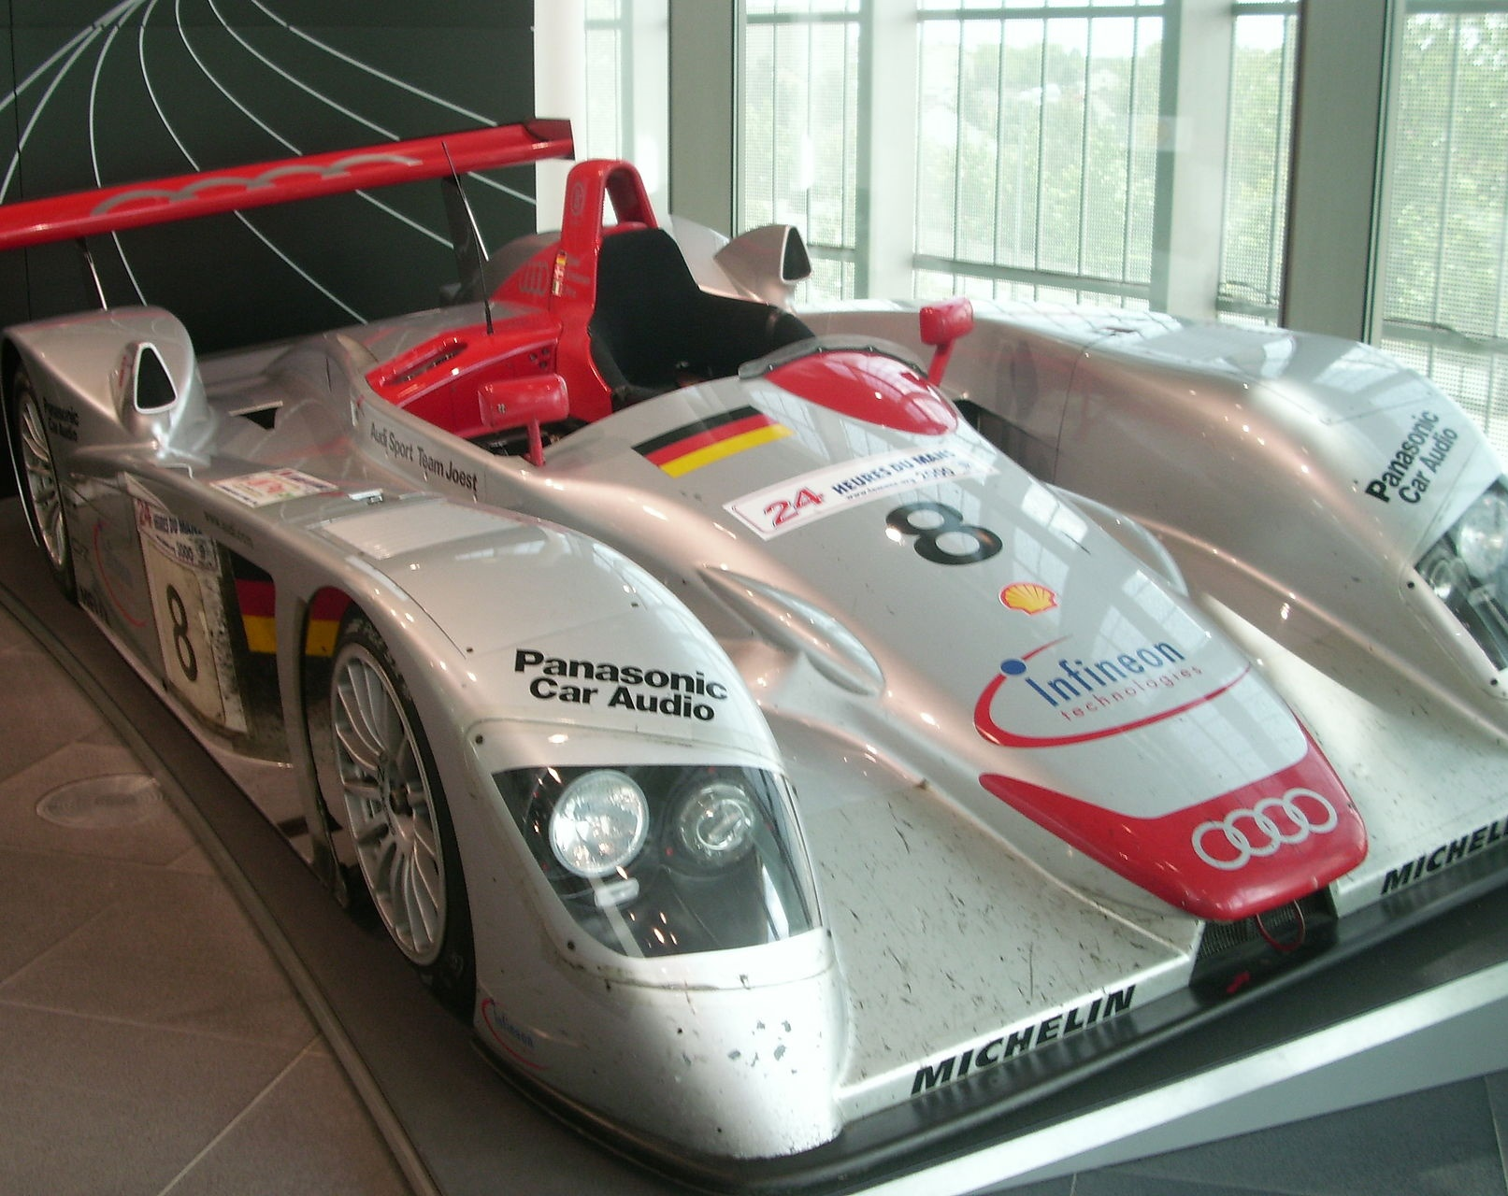
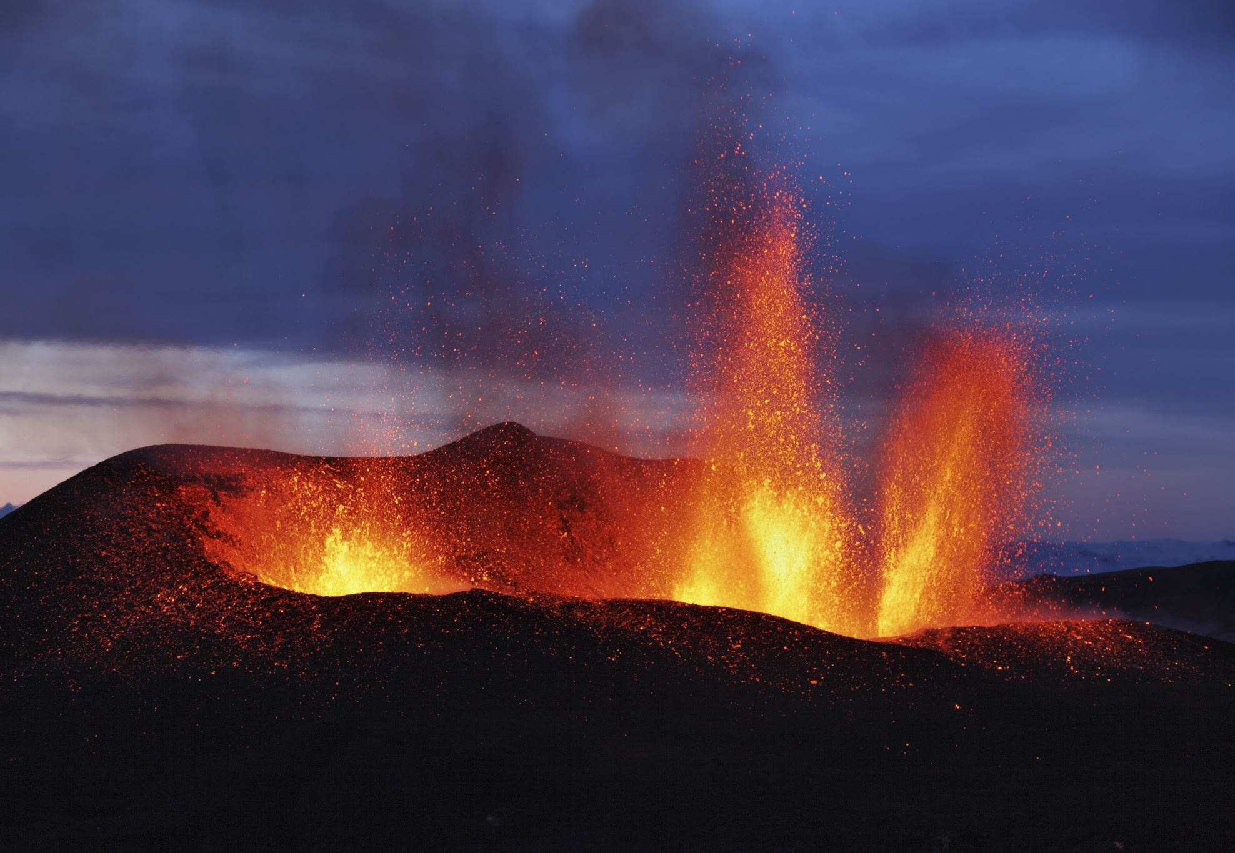
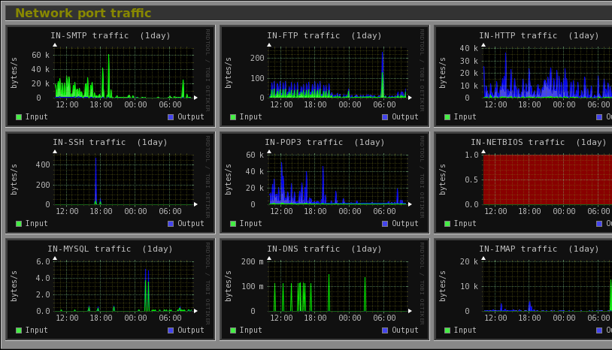

Slide 12
